Slide 1
Digital Design and Artificial Intelligence
Digital Design Foundations: Logic gates and circuits process binary data, essential for all computing systems.
AI Needs Digital Hardware: AI models rely on efficient digital circuits to handle massive data and computations.
Digital design enables AI in applications like smart devices, autonomous cars, and healthcare tech.

Slide 2
Agenda
A Brief Introduction to AI Fundamentals and Algorithms
Convolutional Neural Network
Dataset
MATLAB
Classify Time Series Using Wavelet Analysis and Deep Learning

Slide 3

A Brief Introduction to AI Fundamentals and Algorithms
What is Artificial Intelligence(AI)?
History of AI
Machine Learning
Natural Language Processing
Deep Learning
Machine Translation
Convolutional Neural Network
Large Language Models
Risks of AI
Future Direction
Summary

Slide 4
What is Artificial Intelligence(AI)?
What is Intelligence?
Human made machine or human written program to think and learn like humans
“The branch of computer science that is concerned with the automation of intelligent behavior(George F. Luger, William A. Stubblefield)
The capability of a machine to imitate intelligent human behavior.

Slide 5
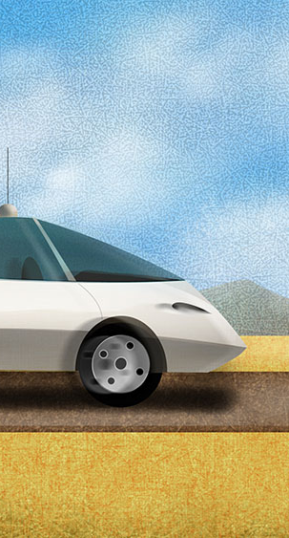
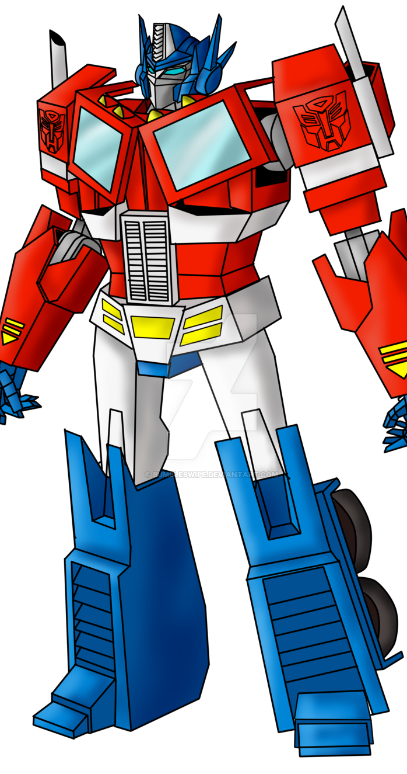
Principles of AI
Intelligent machines can understand, think, plan, and talk
Perceiving the environment and the ability to move and manipulate objects
It is the science and engineering of developing intelligent machines with intelligent computer programs

Slide 6
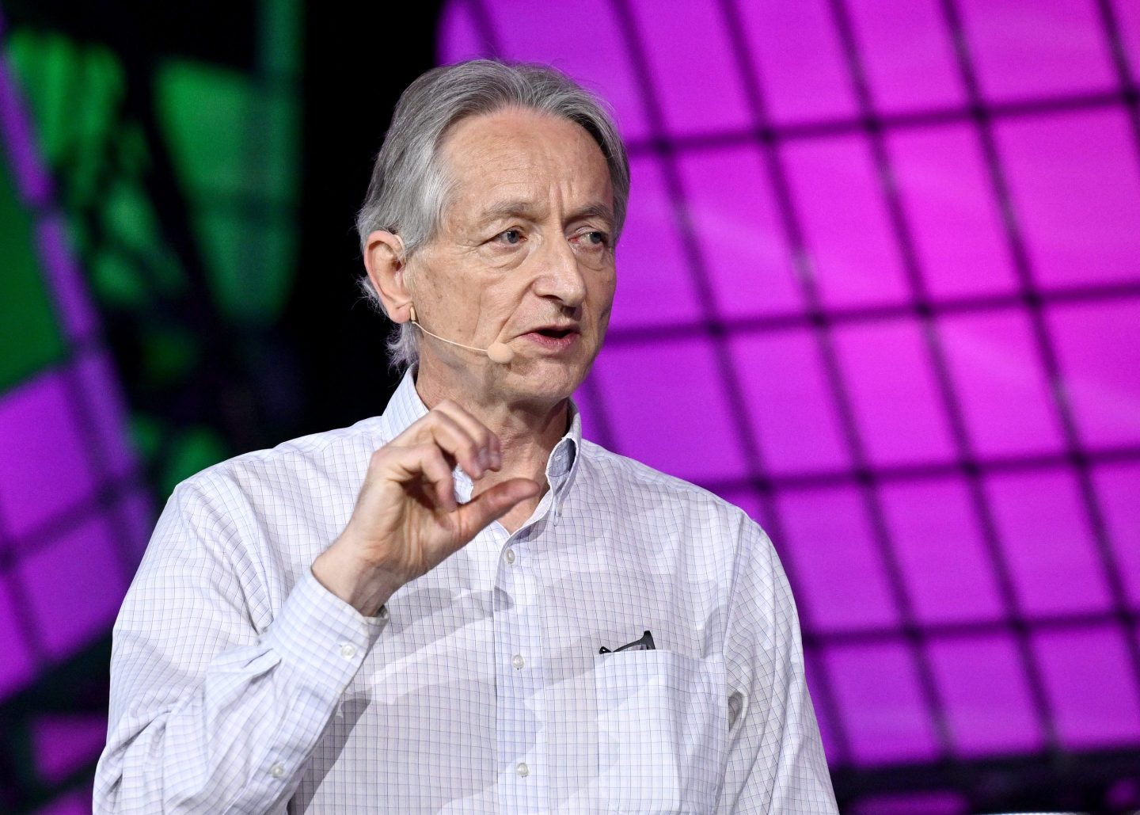
History of AI
1950
In 1950 Alan Turing published a paper titled “Computing Machinery and Intelligence” that asked, “Can machines think?”
1956
In 1956 Darthmouth Conference the term ‘AI’ was proposed
1960s and the 1970s
In 1960s and the 1970s, AI research was focused on the development of Knowledge based system and expert systems
Late 1980s and 1990s
In late 1980s and 1990s , the impact of the back propagation algorithm
2024
Until Now: Machine Learning, Deep Learning, Natural Language Processing, ChatGPT and many more
Geoffrey Hinton, godfather of AI

Slide 7
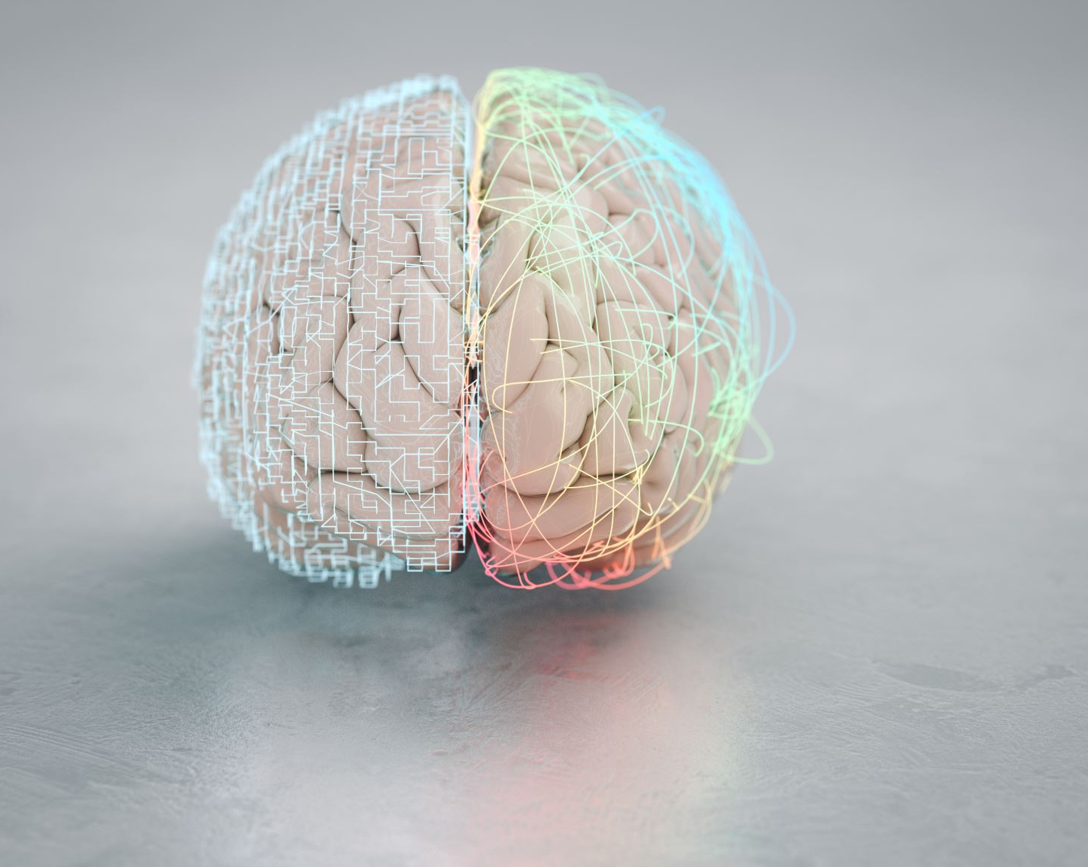
Machine Learning
AI and Machine Learning are different
AI is a vast concept, while ML is the widely used method of AI
ML is a subfield of AI
ML is programming machines to optimize a performance criterion using datasets or experience

Slide 8
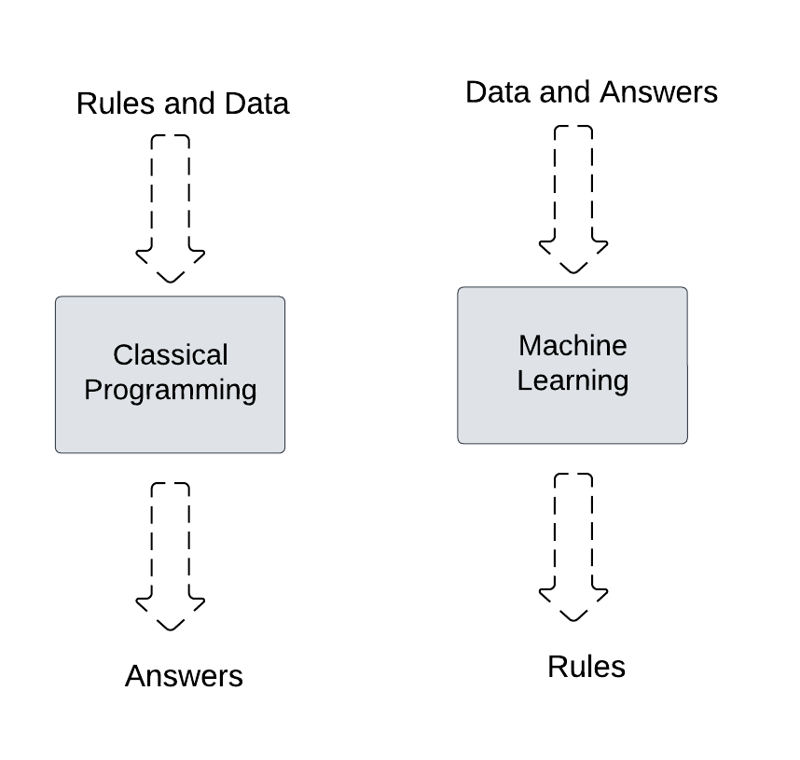
Classical Programming vs Machine Learning

Slide 9
Datasets in Machine Learning
Data or examples
Used to train, evaluate and test ML models
Two main components: Feature and Labels
Text data, Audio data, Image data, Video data and Tabular data

Slide 10

MNIST Handwritten Datasets
This is a dataset of 60,000 28x28 grayscale images of the 10 digits, along with a test set of 10,000 images.
https://keras.io/api/datasets/mnist/

Slide 11
MIT-BIH Arrhythmia Database
https://archive.physionet.org/cgi-bin/atm/ATM

Slide 12
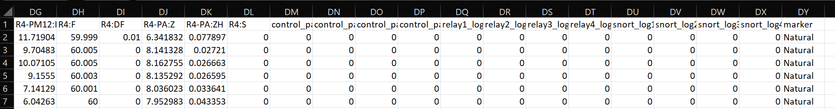
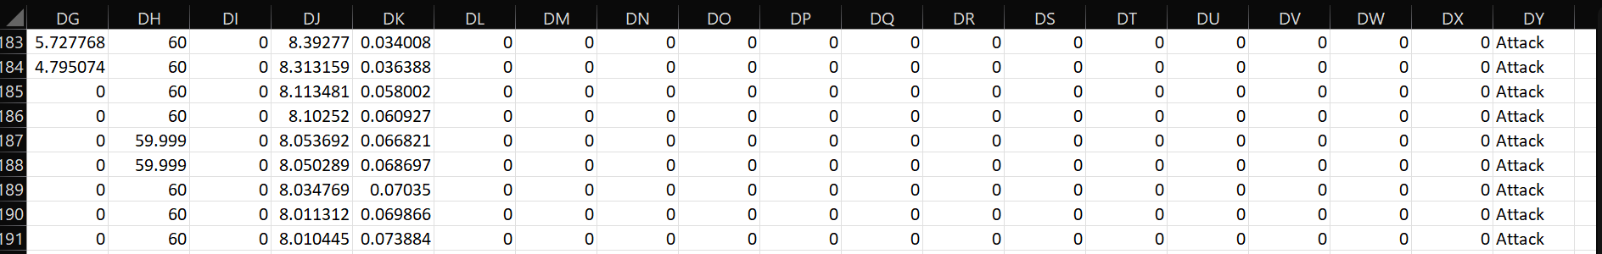
Power System Dataset
Tabular Datasets with labels
https://sites.google.com/a/uah.edu/tommy-morris-uah/ics-data-sets

Slide 13
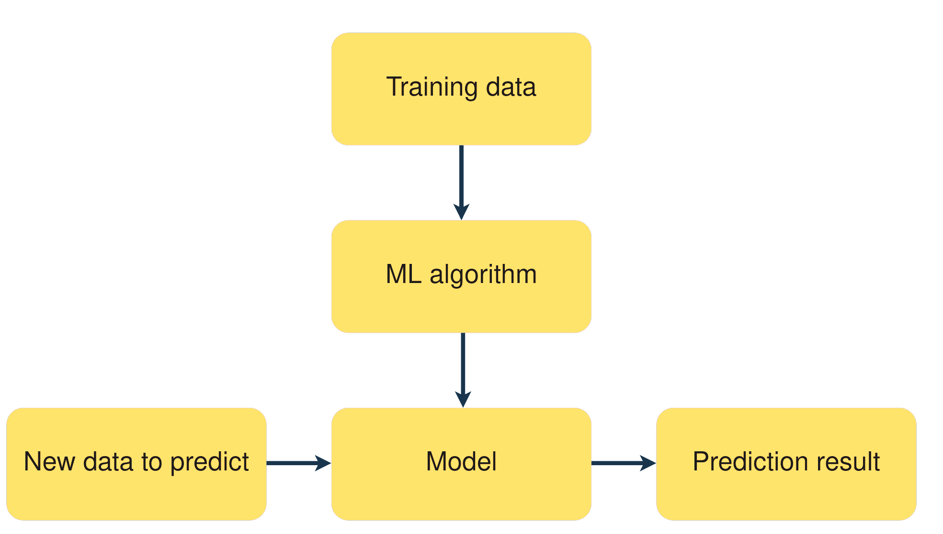
ML Algorithm
Set of step-by-step rules that an ML model rely on
Design ML model that learn from dataset and make prediction/decisions
Learning Style
Supervised Learning
Unsupervised Learning
Semi-Supervised Learning

Slide 14

Ordinary Example
AI Model
It is a Dog!
Input/Command
Process/Think/ Learn
Output/Response

Slide 15

Application of ML
Market Analysis
Finance
Manufacturing
Medical
Bioinformatics
Telecommunication
Search Engines
Natural Language Processing/Understanding

Slide 16
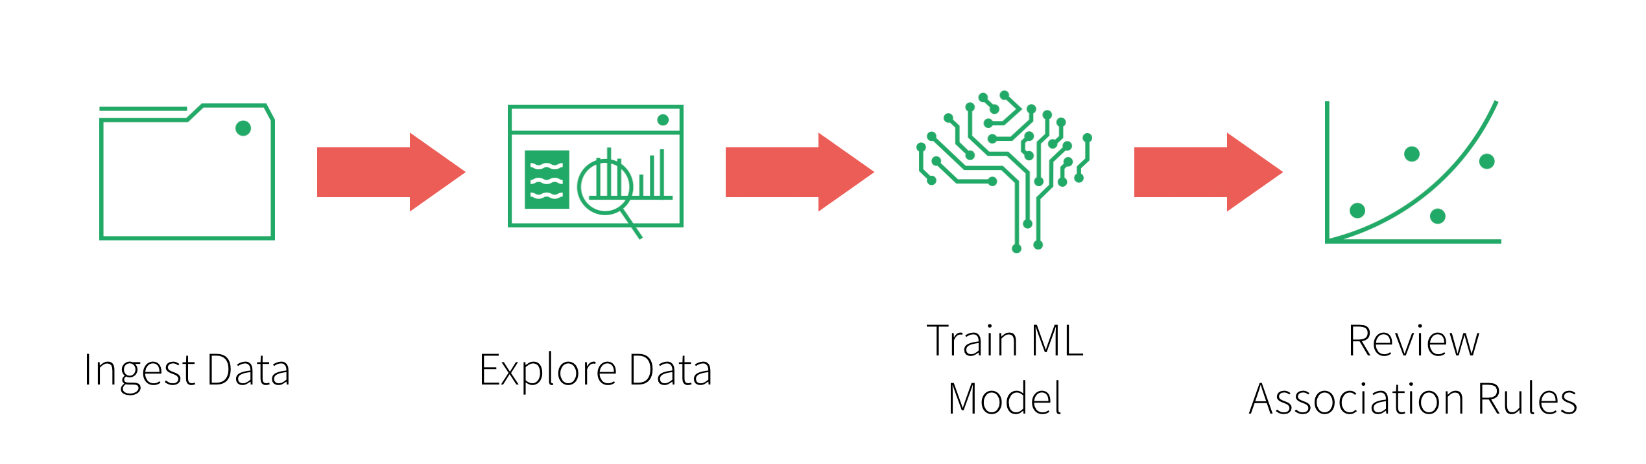
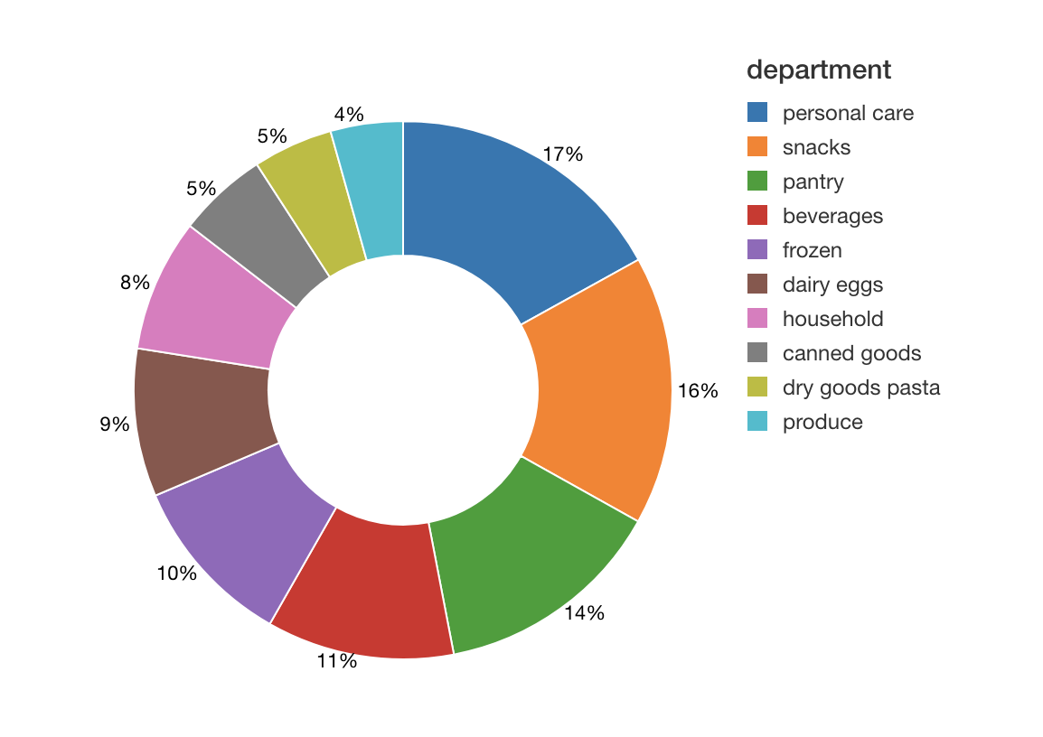
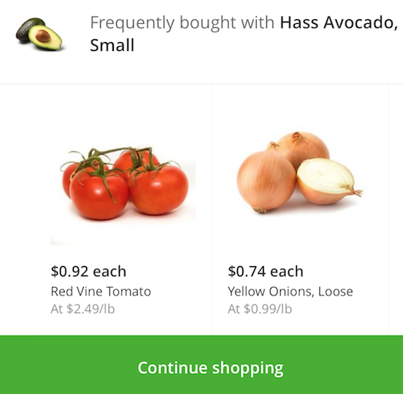
Market Basket Analysis
https://www.databricks.com/blog/2018/09/18/simplify-market-basket-analysis-using-fp-growth-on-databricks.html

Slide 17
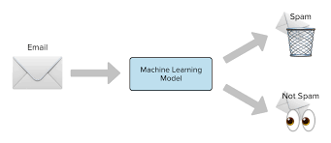
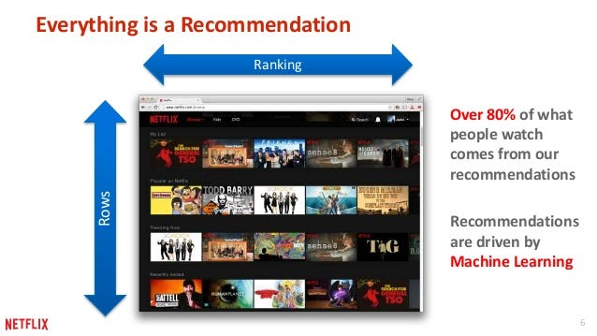
ML Models for Specific Application
Spam Detection: Naïve Bayes, Support Vector Machines(SVM)
Anomaly Detection: K-Nearest Neighbor(KNN), Isolation Forest
Finance: Logistic Regression, Random Forrest
Fraud Detection: Random Forest, Gradient Boosting
Sentiment Analysis: Naïve Bayes, SVM
Recommendation: K-NN
https://towardsdatascience.com/prototyping-a-recommender-system-step-by-step-part-1-knn-item-based-collaborative-filtering-637969614ea

Slide 18
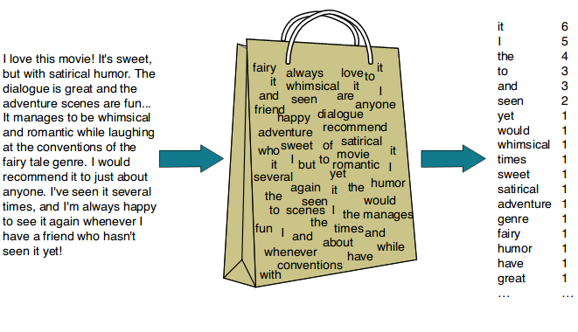
Natural Language Processing(NLP)
To process information contained in natural language
We use AI/ML models to classify texts-based information
Two components:
Natural Language Understanding
Natural Language Generation

Slide 19
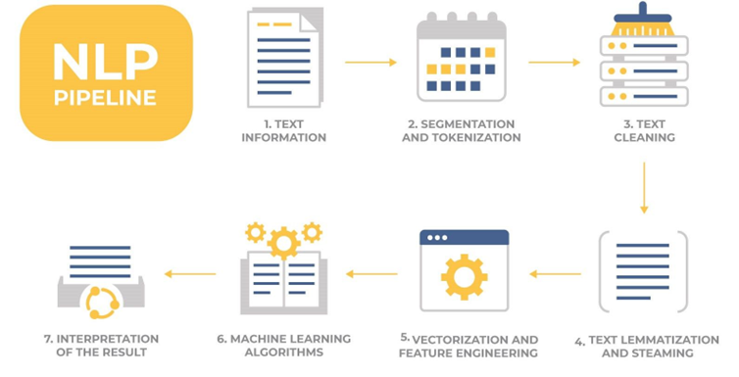
NLP Pipeline
Original Text: "The cats are jumping on the roofs."
Tokenization: ["The", "cats", "are", "jumping", "on", "the", "roofs"]
Lemmatization: ["The", "cat", "be", "jump", "on", "the", "roof"]
Vectorization (e.g., using Bag of words): Numeric vectors representing the lemmatized tokens.
https://thmachne.blogspot.com/2021/07/nlp-or-machine-learning.html

Slide 20
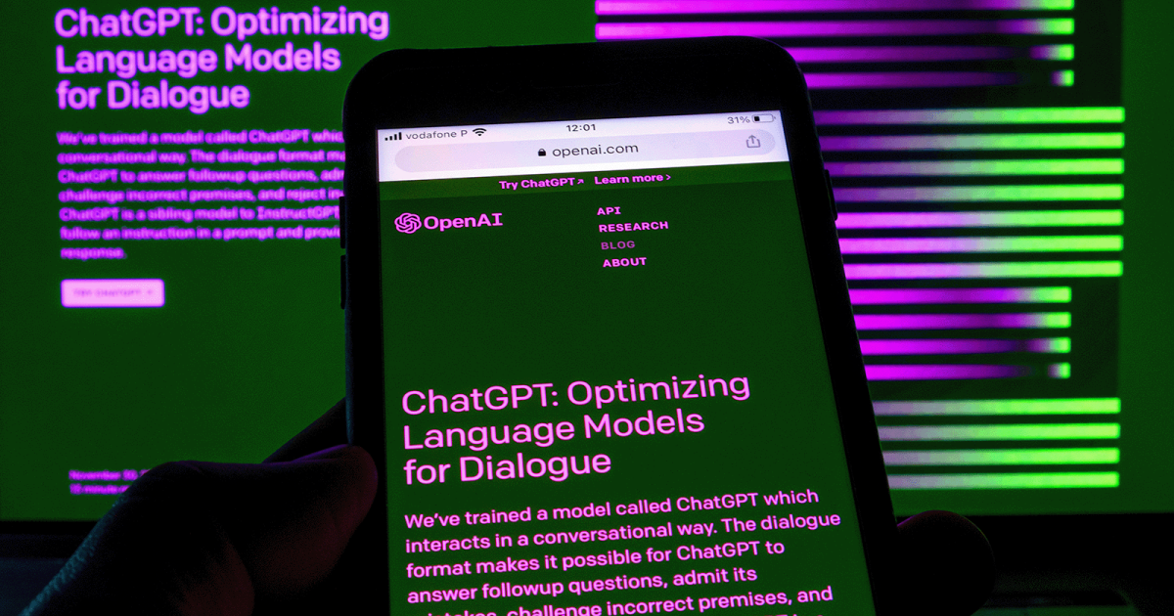
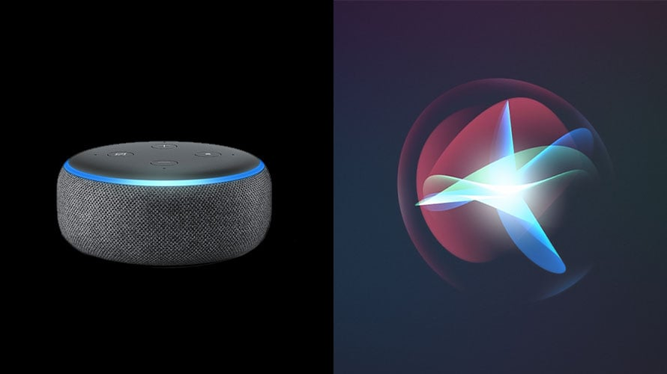
Application of NLP
Text Classification
Machine Translation
Speech Recognition
Chatbots and Virtual Assistants
Information Retrieval
Content Generation
Accessibility

Slide 21
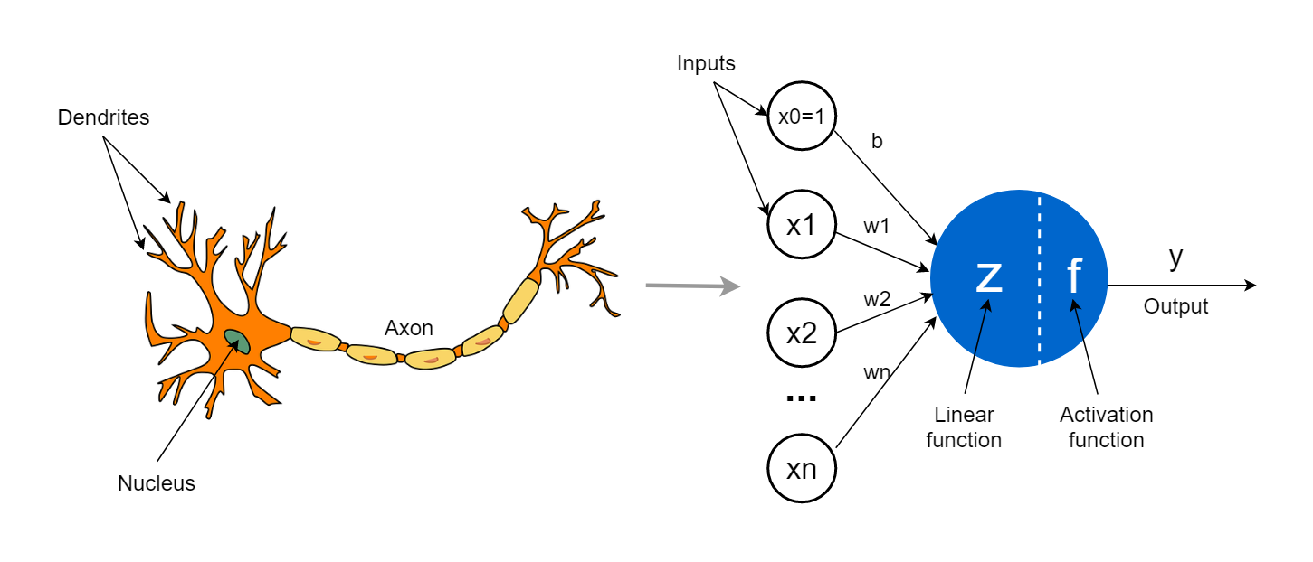
Deep Learning
Subfield of Machine Learning
Development of artificial neural network
Inspired by the structure and function of the human brain
Image from: https://towardsdatascience.com/the-concept-of-artificial-neurons-perceptrons-in-neural-networks-fab22249cbfc

Slide 22
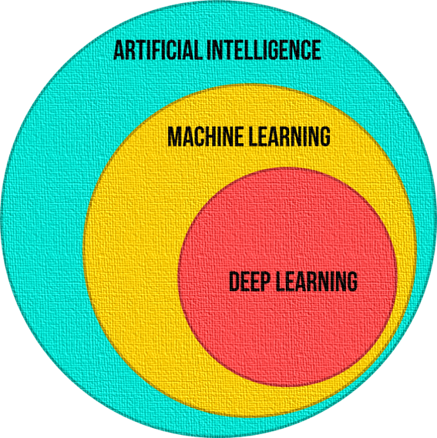
AI vs ML vs DL
1
2
3

Slide 23
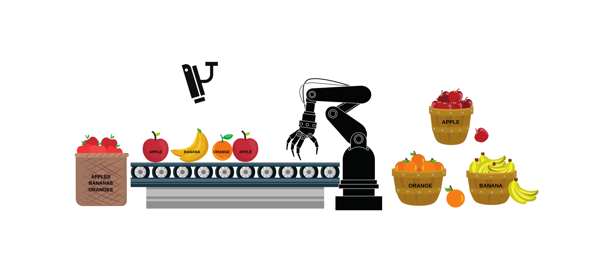
1. Artificial Intelligence
https://www.advancinganalytics.co.uk/blog/2021/12/15/understanding-the-difference-between-ai-ml-and-dl-using-an-incredibly-simple-example

Slide 24
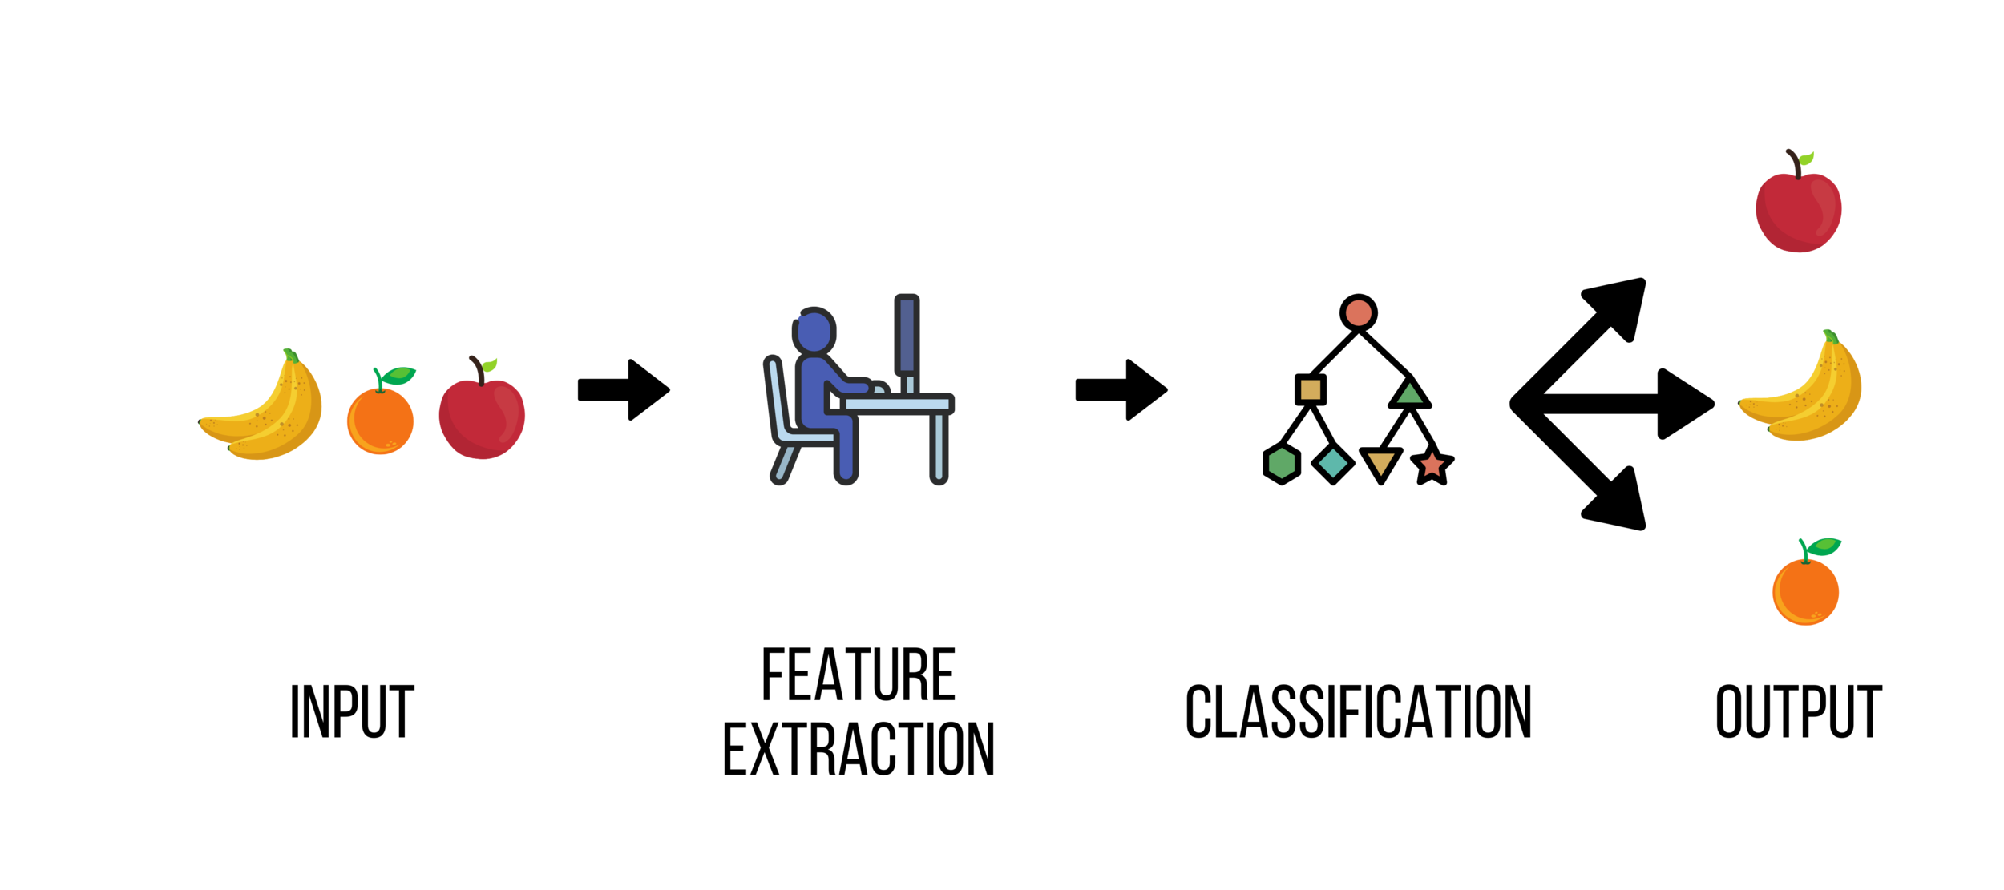
2. Machine Learning
https://www.advancinganalytics.co.uk/blog/2021/12/15/understanding-the-difference-between-ai-ml-and-dl-using-an-incredibly-simple-example

Slide 25
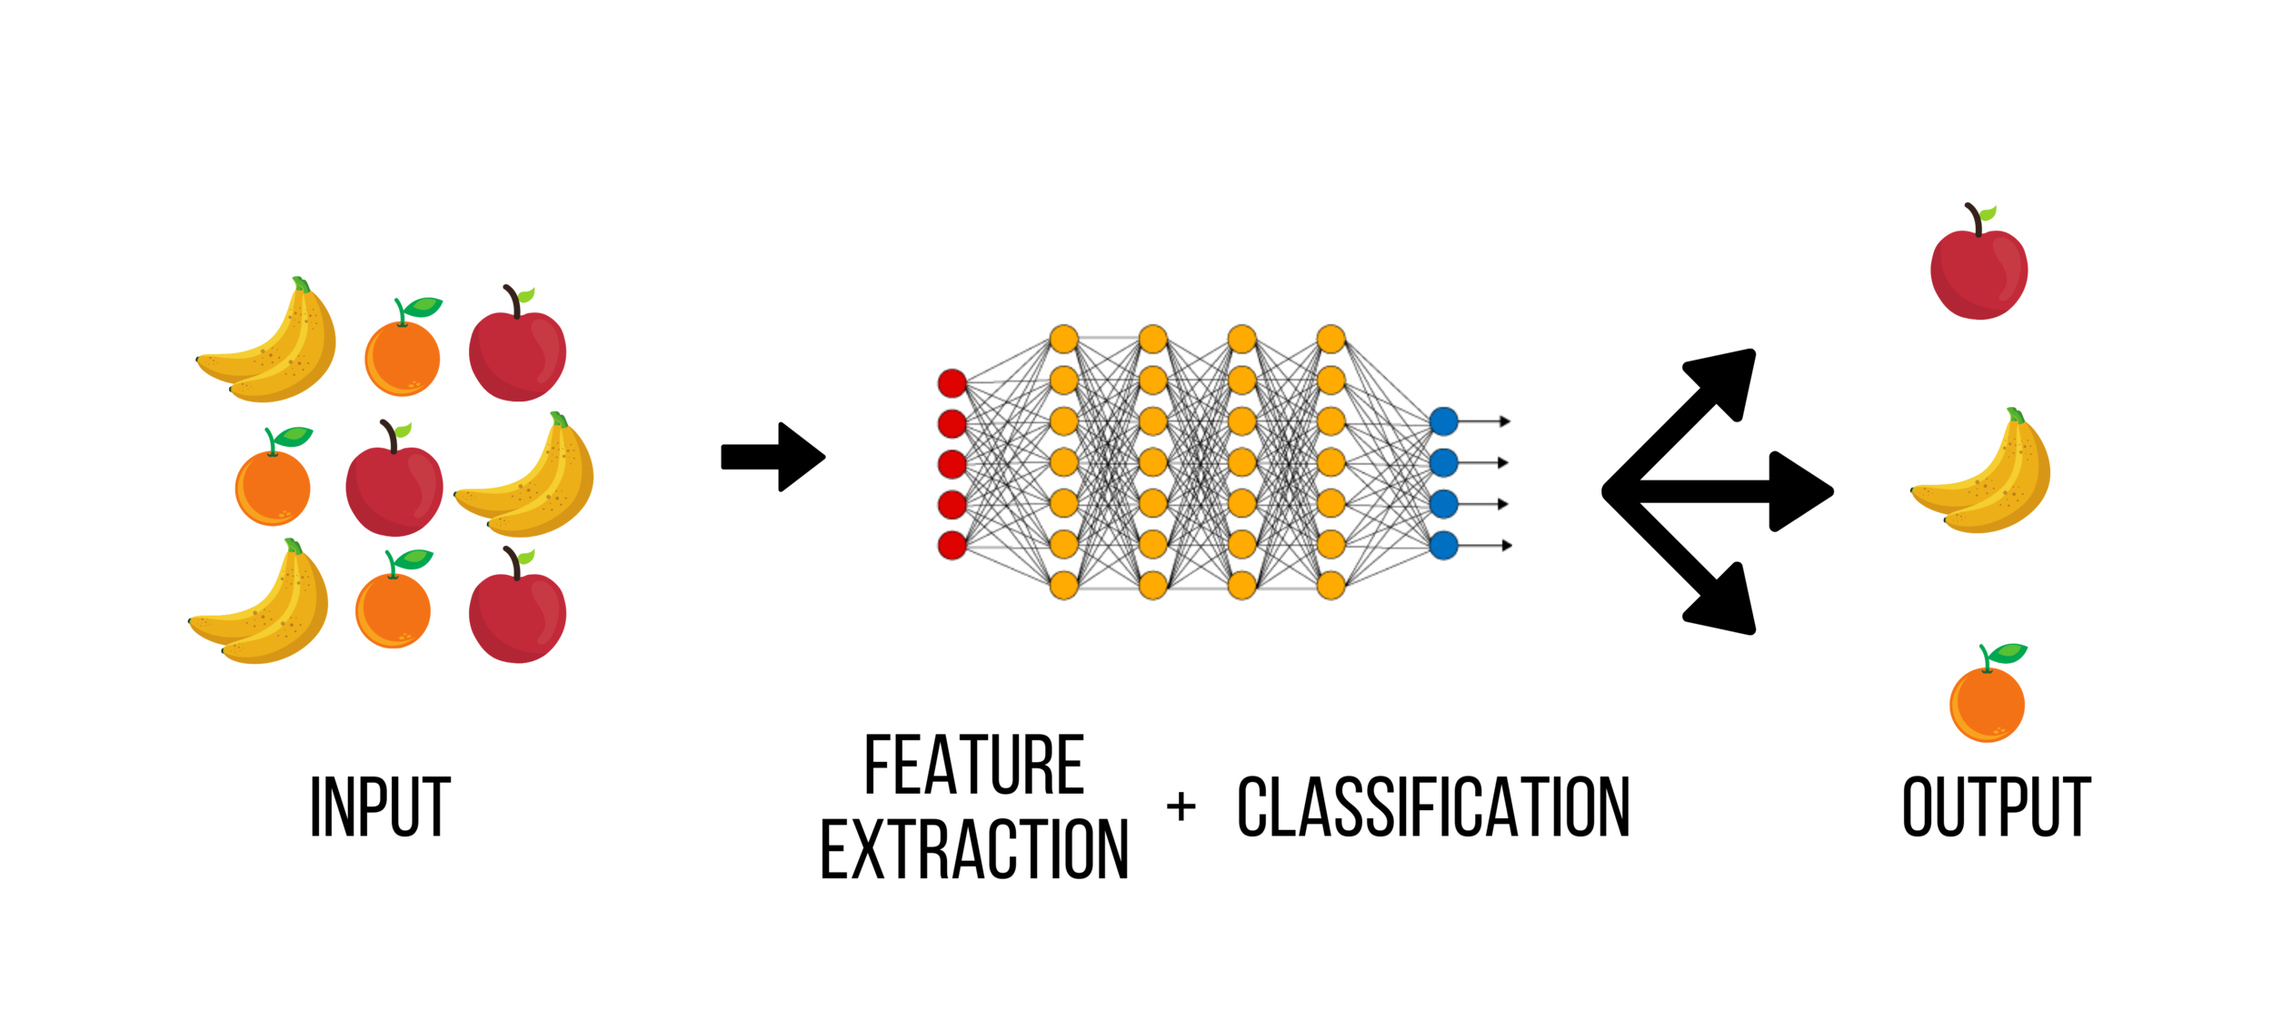
3. Deep Learning
https://www.advancinganalytics.co.uk/blog/2021/12/15/understanding-the-difference-between-ai-ml-and-dl-using-an-incredibly-simple-example

Slide 26

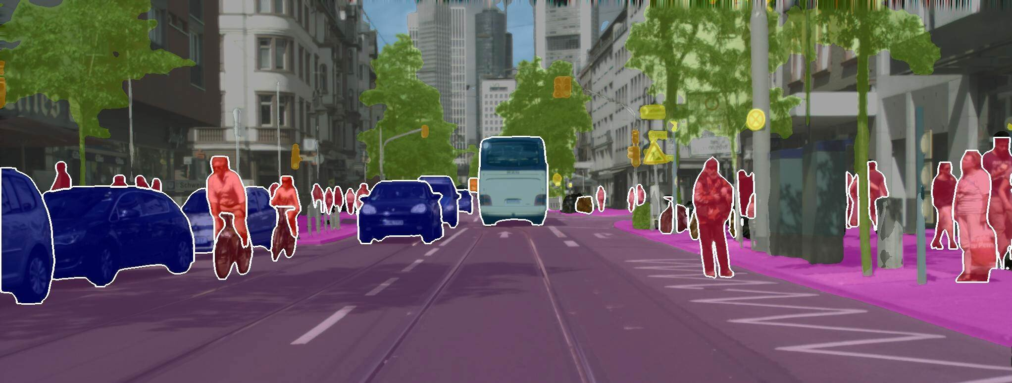
Application of Deep Learning
Computer Vision
Natural Language Processing: MT
Speech Recognition
Autonomous Vehicles
Healthcare
Energy
Agriculture

Slide 27
Machine Translation(MT)
Subfield of computational linguistics
Deep Learning has given rise to Neural Machine Translation(NMT)
NMT is the most powerful algorithm to perform translation
Example: Google Translate, DeepL
Massive datasets of translated sentences are used to train a model capable of translating between any two languages

Slide 28
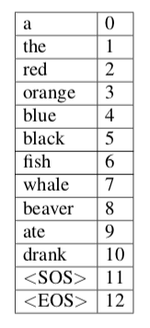
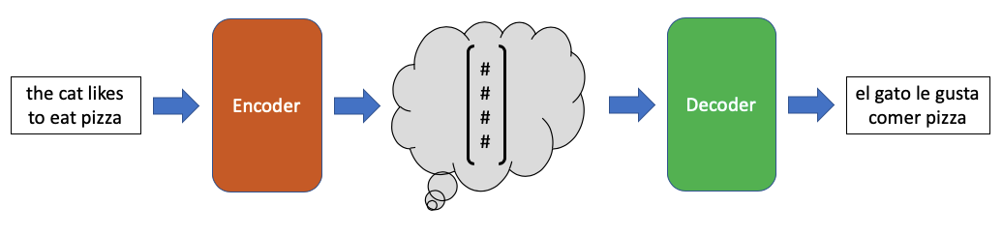
Encoder and Decoder Algorithm For NMT
Figure : Encoder Decoder structure translating the English sentence
Table : Mini-vocabulary for the English language
Encoder Decoder are DL models such as Convolutional Neural Network and Recurrent Neural Network
Image from: https://towardsdatascience.com/neural-machine-translation-15ecf6b0b

Slide 29
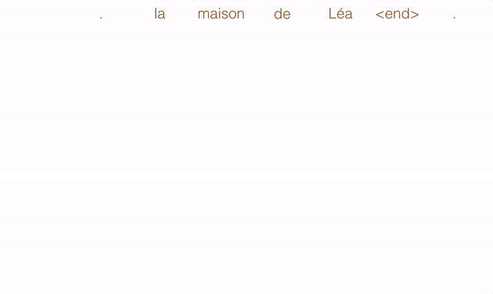
Convolutional Neural Network
Deep Learning Algorithm
Used for various applications such as image classification, medical diagnosis and translation
The basic concept underlying CNNs for translation is that it compute a vector for every possible phrase
https://engineering.fb.com/2017/05/09/ml-applications/a-novel-approach-to-neural-machine-translation/
https://medium.com/ai-society/why-convolutional-neural-networks-are-a-great-architecture-for-machine-translation-9258ca1263a8

Slide 30
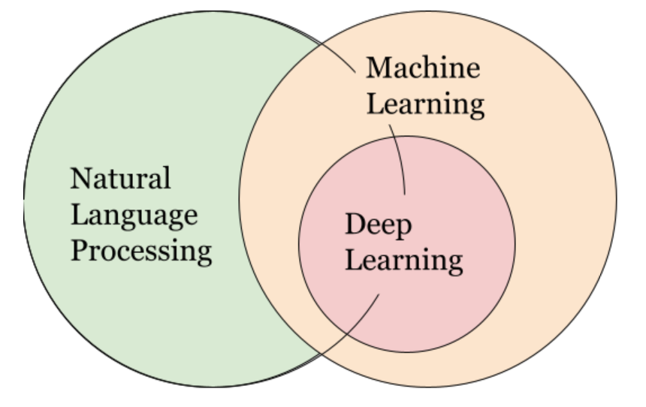
NLP, ML and DL

Slide 31
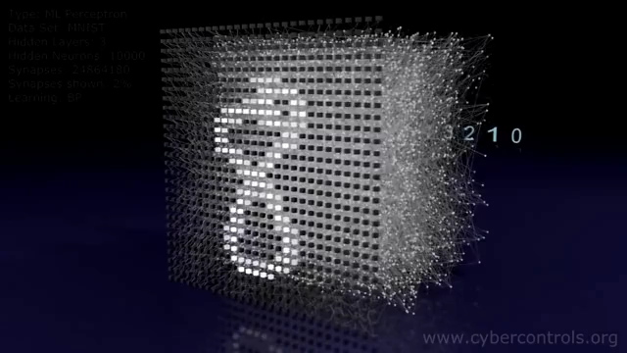
Classifying Images of Handwritten Digits using Multi-Layer Perceptron
Video:
https://thumbs.gfycat.com/SlushySlimGalapagosmockingbird-mobile.mp4

Slide 32
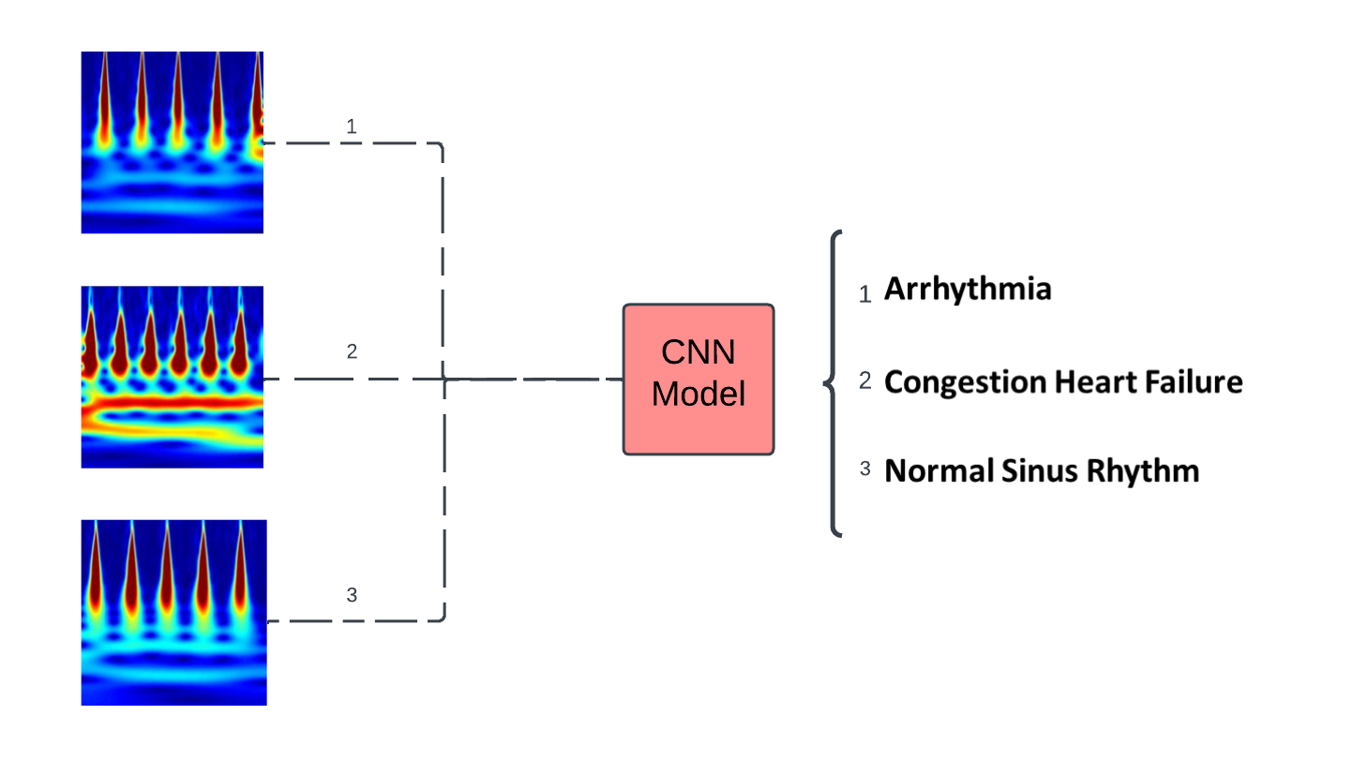
Another CNN Application
Various ECG Scalograms
Input/Command
Process/Think/ Learn
Output/Response

Slide 33

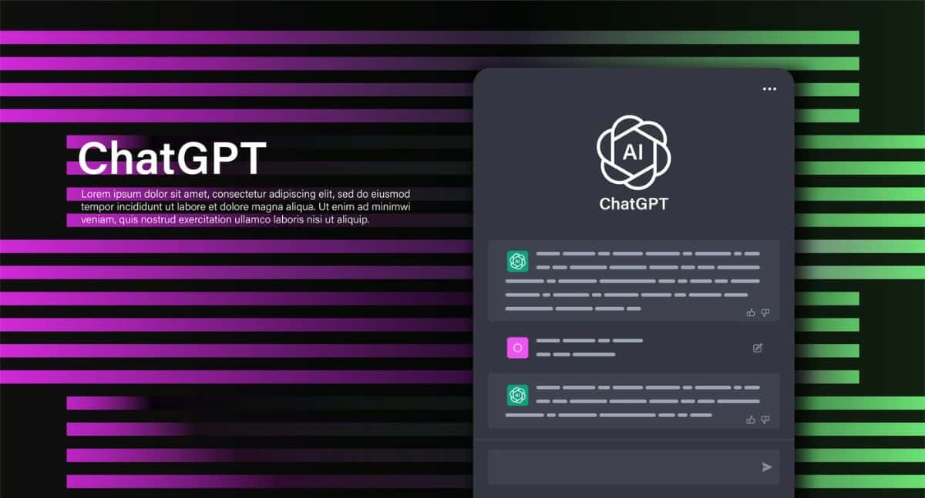

Large Language Models(LLM)
Technology to understand and generate human language
Based on Deep Learning
More specifically based on transformer architecture
Trained on huge amount of texts data
Fine-tuning for specific application
https://crfm.stanford.edu/2023/03/13/alpaca.html https://blog.google/technology/ai/google-bard-updates-io-2023/ https://blog.enterprisedna.co/how-to-use-chat-gpt/

Slide 34
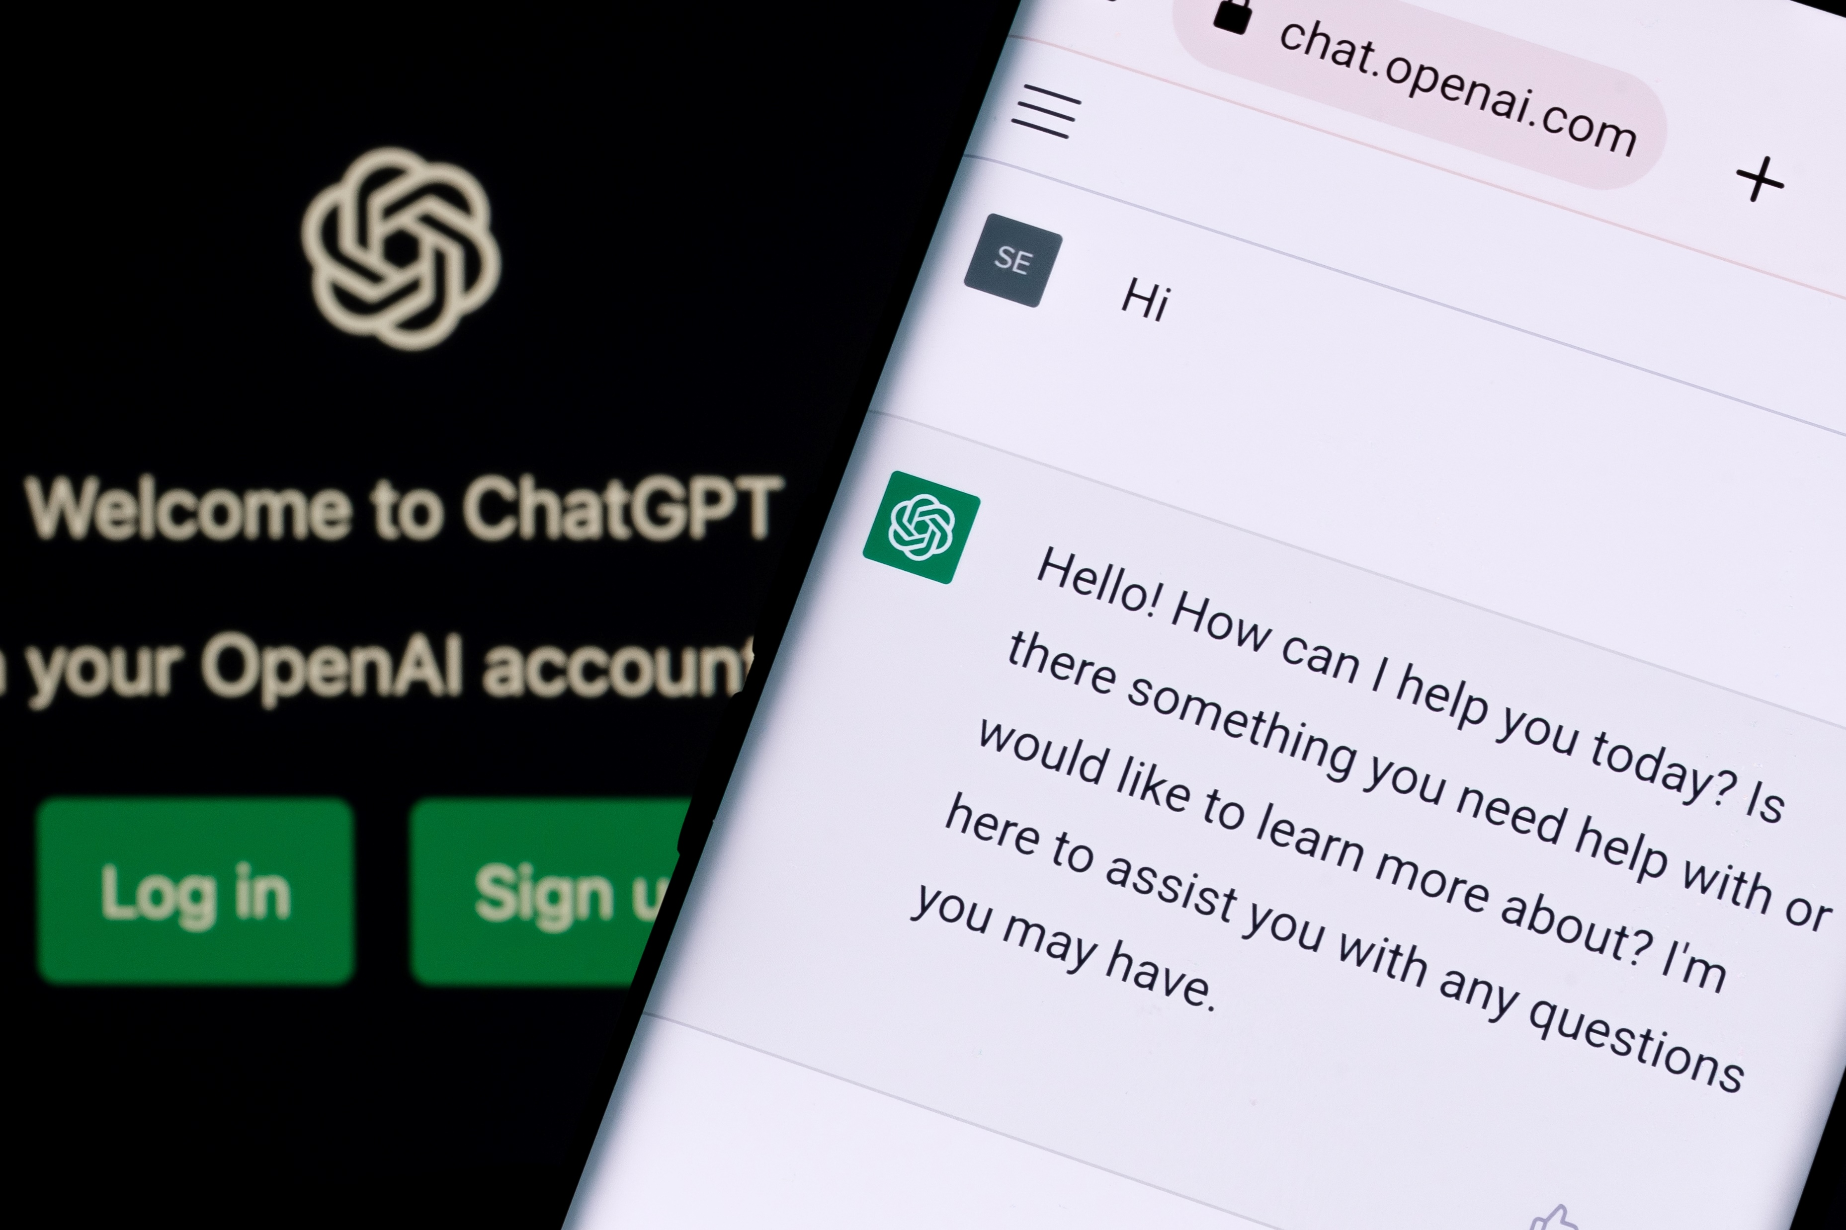
ChatGPT
https://chat.openai.com
Model names: GPT-3.5 / GPT-4
Content Generation
Virtual Assistants
Language Translation
Teaching Assistant
Research

Slide 35
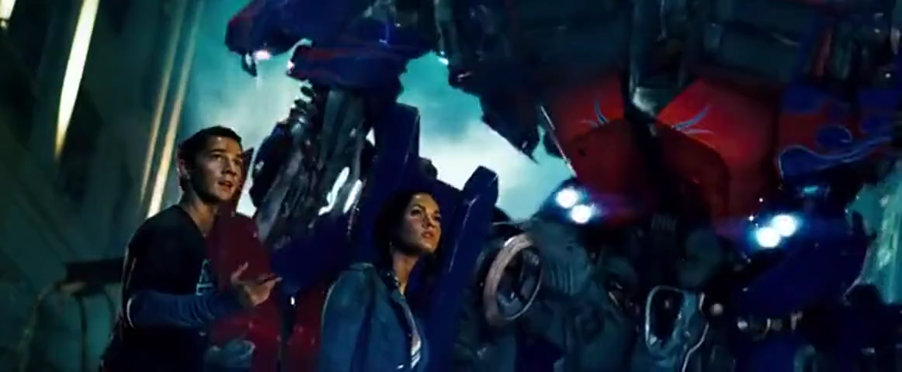
From the Movie Transformers(2007)
Video:
We have learned Earth’s languages from the world wide web

Slide 36
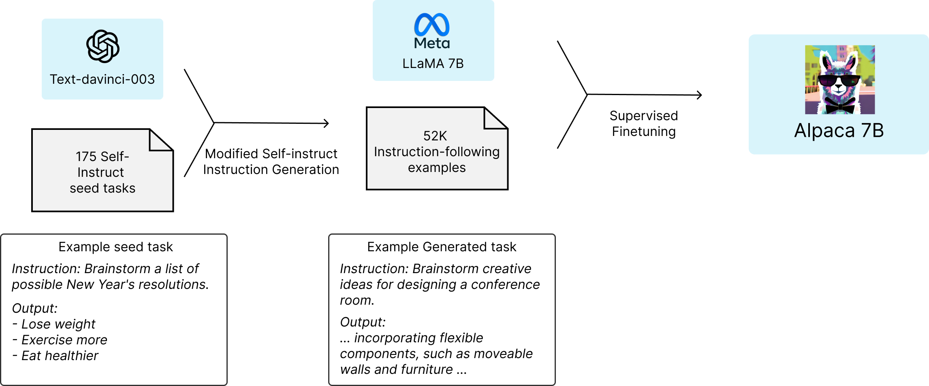
Stanford Alpaca: A Language Model
https://crfm.stanford.edu/2023/03/13/alpaca.html

Slide 37
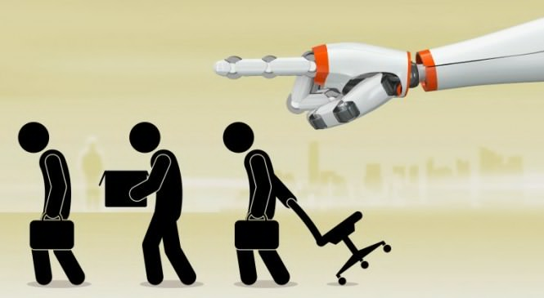

Risks of AI
Transparency
Bias and Discrimination
Privacy Concerns
Security Risks
Job Displacement
Dependence on AI
Loss of Human Connection
Existential Risks
https://www.forbes.com/sites/bernardmarr/2023/06/02/the-15-biggest-risks-of-artificial-intelligence/?sh=62915ca27066

Slide 38
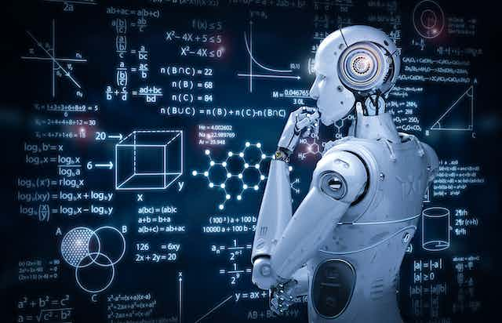
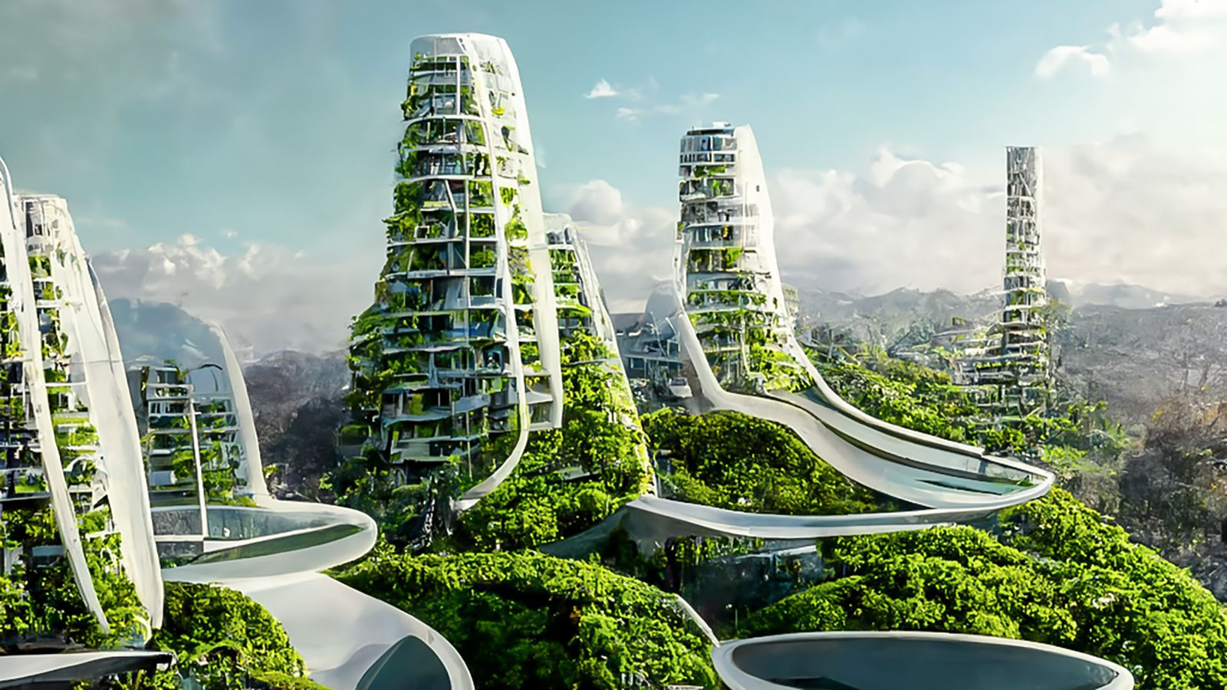
Future Direction
The future is really unknown
Undоubtedly hаve bоth роsitive аnd negative imрliсаtiоns.
However, AI will continue to get more sophisticated
Continue to impact: Transportation, Education, Healthcare, Media, Manufacturing, Customer Service and many more
https://www.simplilearn.com/future-of-artificial-intelligence-article#:~:text=leap%20of%20faith.-,Future%20of%20Artificial%20Intelligence,healthcare%2C%20banking%2C%20and%20transportation.
https://builtin.com/artificial-intelligence/artificial-intelligence-future

Slide 39
Convolutional Neural Network
Deep Learning Algorithm
Used for various applications such as image classification, medical diagnosis and translation
https://engineering.fb.com/2017/05/09/ml-applications/a-novel-approach-to-neural-machine-translation/
https://medium.com/ai-society/why-convolutional-neural-networks-are-a-great-architecture-for-machine-translation-9258ca1263a8

Slide 40
CNN Application
Various ECG Scalograms
Input/Command
Process/Think/ Learn
Output/Response

Slide 41
References
https://keras.io/api/datasets/mnist/
https://archive.physionet.org/cgi-bin/atm/ATM
https://sites.google.com/a/uah.edu/tommy-morris-uah/ics-data-sets
https://www.databricks.com/blog/2018/09/18/simplify-market-basket-analysis-using-fp-growth-on-databricks.html
https://towardsdatascience.com/prototyping-a-recommender-system-step-by-step-part-1-knn-item-based-collaborative-filtering-637969614ea
https://thmachne.blogspot.com/2021/07/nlp-or-machine-learning.html
Image from: https://towardsdatascience.com/the-concept-of-artificial-neurons-perceptrons-in-neural-networks-fab22249cbfc
https://www.advancinganalytics.co.uk/blog/2021/12/15/understanding-the-difference-between-ai-ml-and-dl-using-an-incredibly-simple-example
Image from: https://towardsdatascience.com/neural-machine-translation-15ecf6b0b
https://thumbs.gfycat.com/SlushySlimGalapagosmockingbird-mobile.mp4
https://crfm.stanford.edu/2023/03/13/alpaca.html https://blog.google/technology/ai/google-bard-updates-io-2023/ https://blog.enterprisedna.co/how-to-use-chat-gpt/
https://crfm.stanford.edu/2023/03/13/alpaca.html
https://www.forbes.com/sites/bernardmarr/2023/06/02/the-15-biggest-risks-of-artificial-intelligence/?sh=62915ca27066
https://www.simplilearn.com/future-of-artificial-intelligence-article#:~:text=leap%20of%20faith.-,Future%20of%20Artificial%20Intelligence,healthcare%2C%20banking%2C%20and%20transportation.
https://builtin.com/artificial-intelligence/artificial-intelligence-future

Slide 42

Questions?

